Slide 1
Tunisia

Slide 2
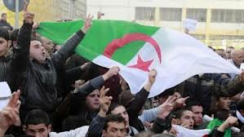
Algeria
The actual situation on the ground remains far from clear. Despite reports that the crisis is over, Algeria's state news agency is saying government troops are only in control of the residential area while the gas facility itself is still surrounded. Not clear whether that means some of the gunmen are still alive or if Algerian troops are concerned about mines and explosives and therefore reluctant to move in.

Slide 3
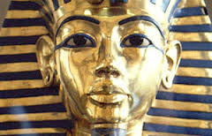
Egypt
Hassan Abu Taleb, an expert at Al-Ahram Center for Political and Strategic Studies, agrees with many analysts who believe the Popular Current’s appeal lies mostly in its symbol, Sabbahi, rather than its ideas.

Slide 4
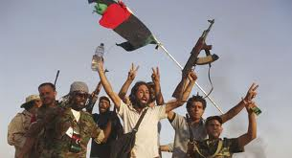
Libya
A rotating cultivation technique in which trees are cut down and burned in order to clear land for temporary agriculture; the land is used until its productivity declines at which point a new plot is selected and the process repeats; this practice is sustainable while population levels are low and time is permitted for regrowth of natural vegetation; conversely, where these conditions do not exist, the practice can have disastrous consequences for the environment .

Slide 5
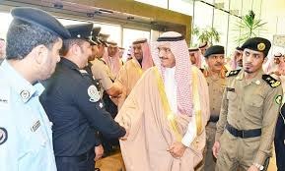
Saudi Arabia
Millions of Saudis struggle on the fringes of one of the world's most powerful economies, where jobs and welfare programmes have failed to keep pace with a population that has soared from 6 million in 1970 to 28 million today.

Slide 6
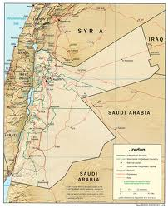
Jordan
Jordan's King Abdullah II may be facing the most serious challenge to his 13-year reign, with this week's protests rocking every corner of the country with some of the worst-ever violence after the government announced the removal of fuel subsidies.

Slide 7
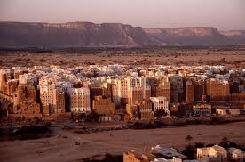
Yemen
In February 2012, Abed Rabbo Mansour Hadi, the country’s former vice president, was elected president. But the reality is that Mr. Saleh still wields considerable influence in Yemen. His relatives control most of the military and government security agencies.

Slide 8
Syria
The capture comes a week after the announcement that one member of the peacekeeping force is missing. The force, known as UNDOF, was established in 1974 following the 1973 Yom Kippur war to monitor the disengagement of Israeli and Syrian forces and maintain a cease-fire

