Slide 1
Terrorism in the Middle east.
Terrorism ahs been effecting the Middle East since the beginning of its foundation.
It started back in 1500 years ago against the jewish resistance groups.

Slide 2
What’s happening with this issue?
Even the Christian crusade, often compared with the Muslim jihad, was itself a delayed and limited response to the jihad and in part also an imitation. But unlike the jihad it was concerned primarily with the defense or reconquest of threatened or lost Christian territory. The Muslim jihad, in contrast, was perceived [by Muslims] as unlimited, as a religious obligation that would continue until all the world had either adopted the Muslim faith or submitted to Muslim rule.… The object of jihad is to bring the whole world under Islamic law.

Slide 3
U.N. Impact on terrorism in the Middle East.
According to the UNODC's World Drug Report 2007, the total potential value of Afghanistan's 2006 opium harvest accruiing to farmers, laboratory owners and Afghan traffickers reached about $US3.1 billion. In addition, it is reported that in 2004, some 400 tons of cocaine was exported from one Latin American country, with an estimated domestic value of US$ 2 billion. How much of this money is used for perpetrating acts of terrorism. Estimates vary. But even a small percentage would be more than sufficient for some individuals or groups to plan, finance and carry out terrorist acts.

Slide 4
Will it be resolved?
I don’t think it will. The middle east has a bad history of terrorism.
Though Hamas paid a heavy price during the bombardment—the destruction of main government buildings,the death of its military commander Ahmed Al Jabbari, as well as, according to estimates, more than 50 other fighters and an unknown amount of munitions destroyed in bombings—it was also able to point to the cease fire as a concrete victory.

Slide 5
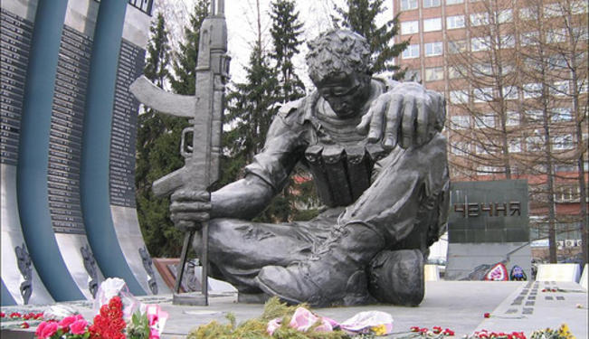
Picrtures of my individual issue.

